Slide 1
Cognitive Graph for Understanding, Reasoning, and Decision
Jie Tang
Computer Science
Tsinghua University
The slides can be downloaded at http://keg.cs.tsinghua.edu.cn/jietang

Slide 2
Machine Learning
ML:
classification
Predict a type of a given example
prediction
e.g., predict whether two nodes are linked

Slide 3
Let us start with a challenging question —Multi-hop Question Answering (QA)

Slide 4

Multi-hop QA
Quality Café
Los Angeles
Alessandro Moschitti
The Quality Cafe is a now-defunct diner in Los Angeles, California. The restaurant has appeared as a location featured in a number of Hollywood films, including Old School, Gone in 60 Seconds, ...
Los Angeles is the most populous city in California, the second most populous city in the United States, after New York City, and the third most populous city in North America.
Alessandro Moschitti is a professor of the CS Department of the University of Trento, Italy. He is currently a Principal Research Scientist of the Qatar Computing Research Institute (QCRI)
Old School
Todd Phillips
Tsinghua University
Old School is a 2003 American comedy film released by Dream Works Pictures and The Montecito Picture Company and directed by Todd Phillips.
Todd Phillips is an American director, producer, screenwriter, and actor. He is best known for writing and directing films, including Road Trip (2000), Old School (2003), Starsky & Hutch (2004), and The Hangover Trilogy.
Tsinghua University is a major research university in Beijing and dedicated to academic excellence and global development. Tsinghua is perennially ranked as one of the top academic institutions in China, Asia, and worldwide...

Slide 5
Challenge 1: Myopic Retrieval Problem
Document A
Old School is a 2003 American comedy film released by DreamWorks Pictures and The Montecito Picture Company…
Document B
Many directors shoot scenes in Hollywood, Los Angeles, which is notable as the home of the U.S. film industry.
However in multi-hop QA, paragraphs multiple hops away from the question could share few common words with the question, leading to a failed retrieval.

Slide 6
Challenge 2: Explainability
Most RC models can only be seen as black-boxes:
Input: The question and a paragraph
Output: The answer span (start and end positions)
To enable a verification by the user, we need:
The reasoning path (graph)
The supporting facts (sentences) at each hop
Other possible answers and their reasoning paths for comparison

Slide 7
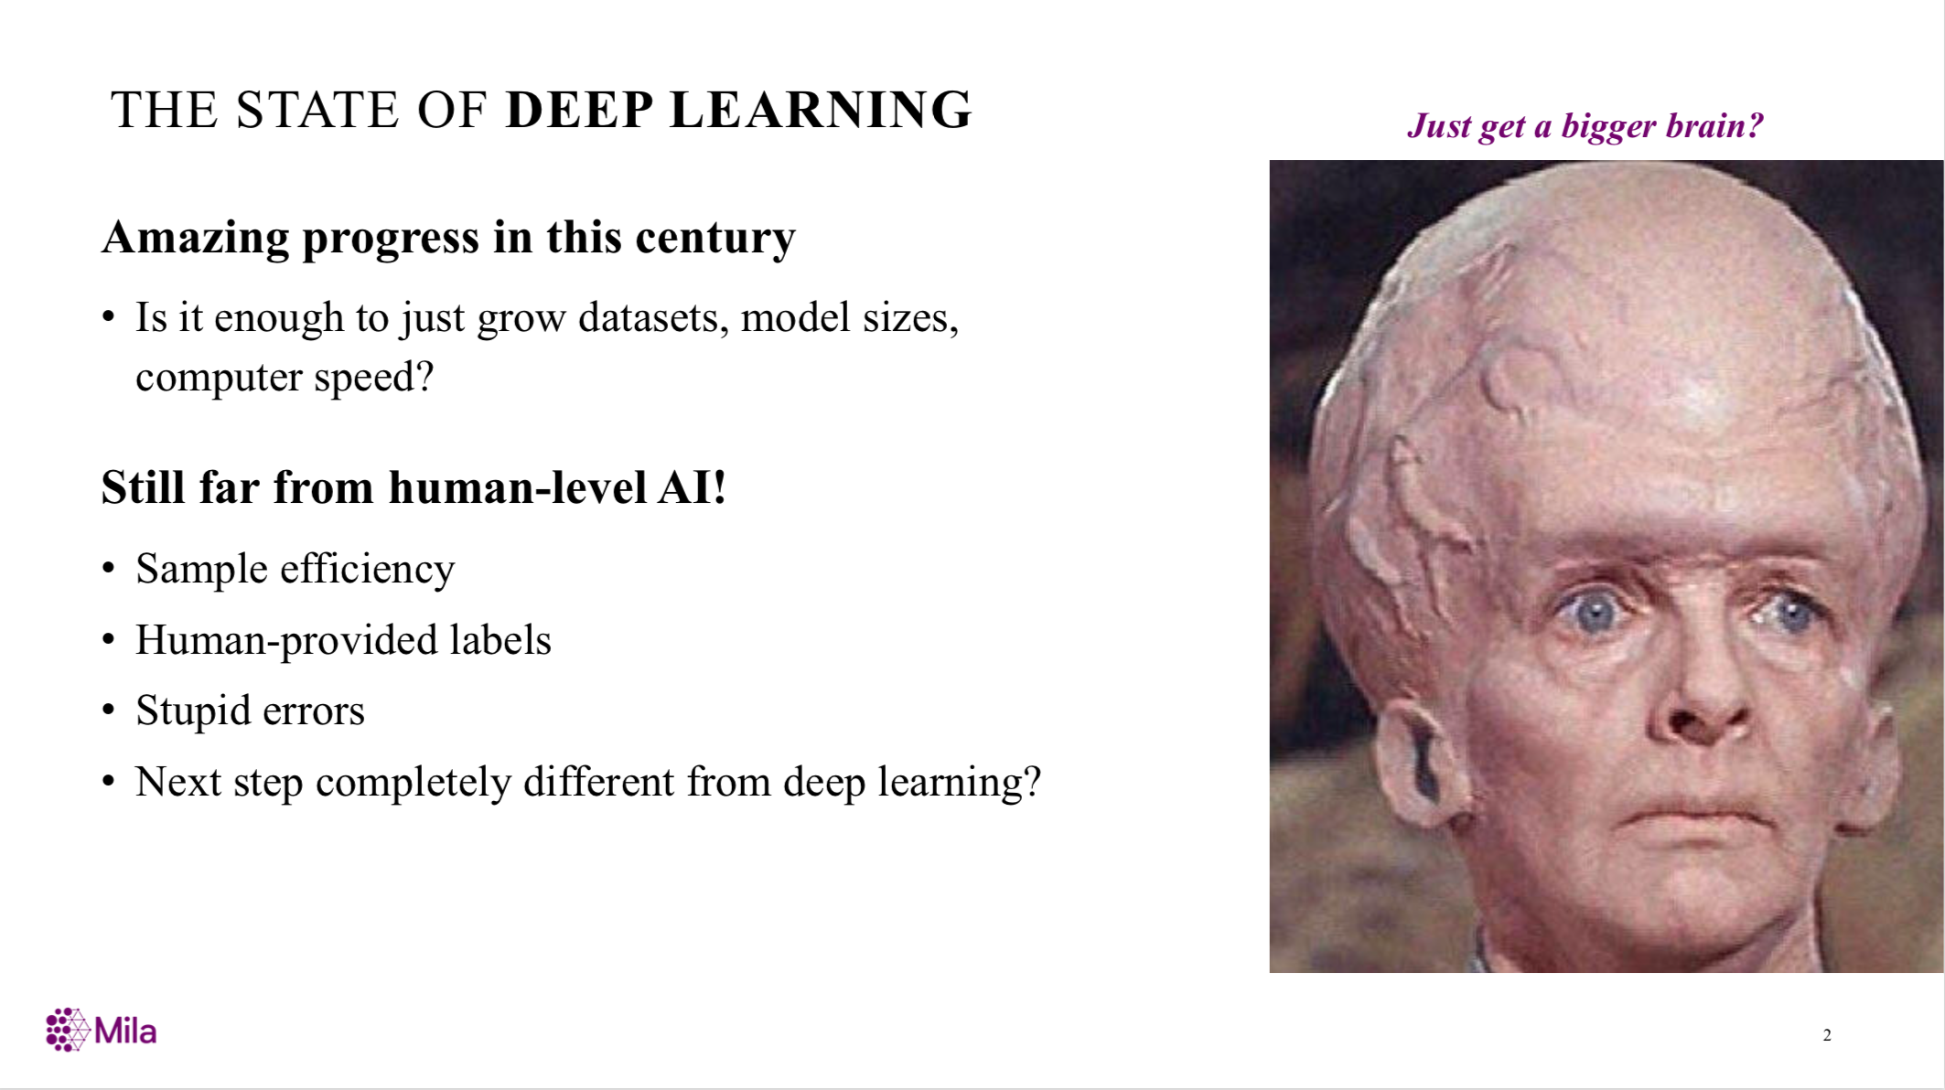
From Bengio’s NIPS’2019 Keynote

Slide 8
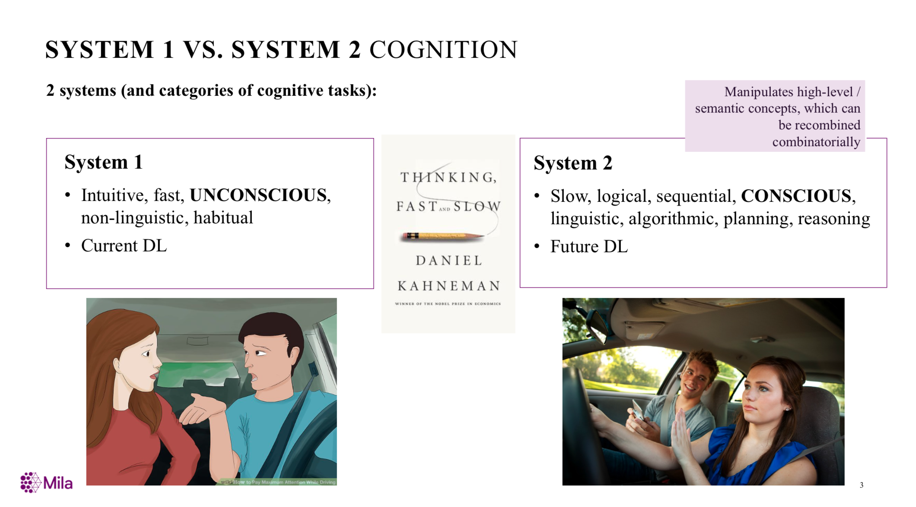
From Bengio’s NIPS’2019 Keynote

Slide 9

Cognitive Graph: Representation, Reasoning, and Decision
Notes:
Imagine a scenario where you have a wikipedia to look up for any entity, and how can you answer such a question?(click)
Question…
We will first search quality café and los angeless which seems useful for answering the question. Okay there are two quality café but we find CLUES in the middle one there are two films featured here. And then we read the paragraph in wiki about the two films and find out there directors.
Now, we construct a graph step by step, which includes all possible and userful information. And our brain will analyze the whole information and gives the final answer.
We name this graph “cognitive graph”.

Slide 10
Connecting to Cognitive Science
System 1
Intuitive
System 2
Analytic
Dual Process Theory
Jonathan St BT Evans. 1984. Heuristic and analytic processes in reasoning. British Journal of Psychology, 75(4):451–468.

Slide 11
Reasoning w/ Cognitive Graph
System 1:
Knowledge expansion by association in text when reading
System 2:
Decision making w/ all the information
System 1
Intuitive
System 2
Analytic
Notes:
Dual process theory in cognition science says:

Slide 12

CogQA: Cognitive Graph for QA
An iterative framework corresponding to dual process theory
System 1
extract entities to build the cognitive graph
generate semantic vectors for each node
System 2
Do reasoning based on semantic vectors and graph
Feed clues to System 1 to extract next-hop entities
System 1
extract
Question
Cognitive Graph
input
Quality café
Los Angeles
…location featured in a number of Hollywood films, including Old School, Gone in 60 Seconds…
clues
Old school
Gone in 60 seconds
System 2
input
Todd Phillips
Dominic Sena
predict

Slide 13
Q1: How to represent a concept in a graph?

Slide 14





Review Representation Learning for Graphs
d-dimensional vector, d<<|V|
Representation Learning/ Graph Embedding
0.8
0.2
0.3
…
0.0
0.0
Users with the same label are located in the d-dimensional space closer than those with different labels
e.g., node classification
label2
label1

Slide 15
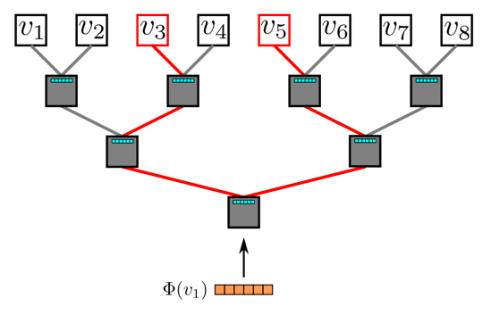
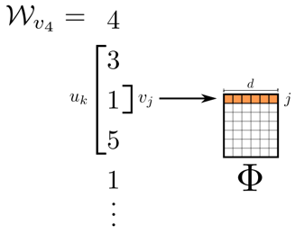
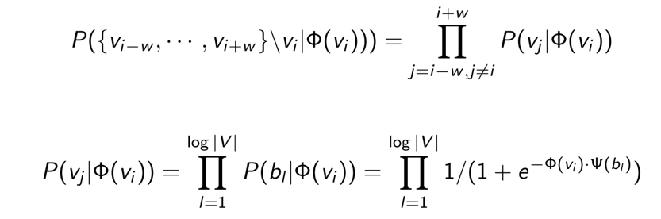
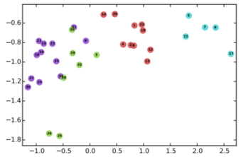
DeepWalk
Random walk
One example RW path
SkipGram with Hierarchical softmax
v₃
v₄
v₄
v₃
v₁
v₅
v₆
v₁
v₅
v₂
v₆
Hierarchical softmax
B. Perozzi, R. Al-Rfou, and S. Skiena. 2014. Deepwalk: Online learning of social representations. KDD, 701–710.

Slide 16
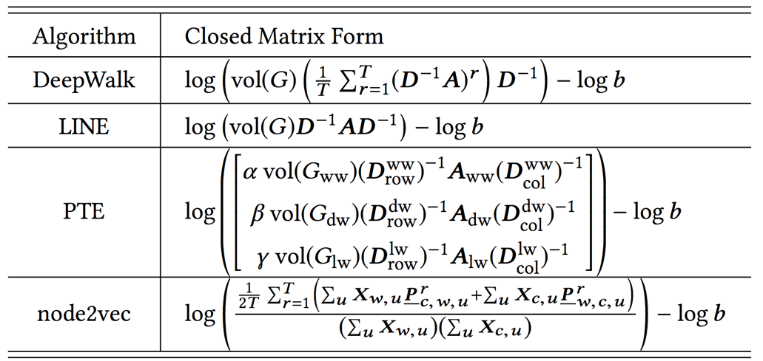
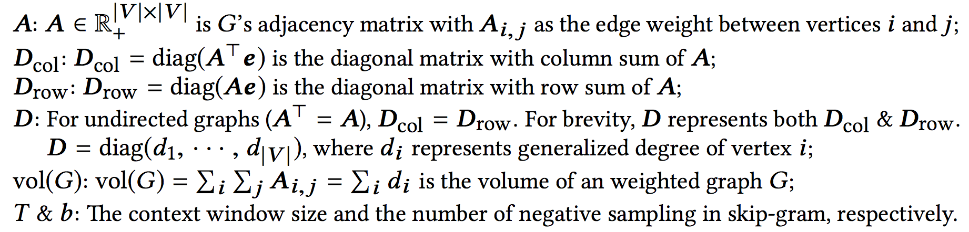
Unifying DeepWalk, LINE, PTE, and node2vec into Matrix Forms
Qiu et al. Network embedding as matrix factorization: unifying deepwalk, line, pte, and node2vec. WSDM’18. The most cited paper in WSDM’18 as of May 2019

Slide 17
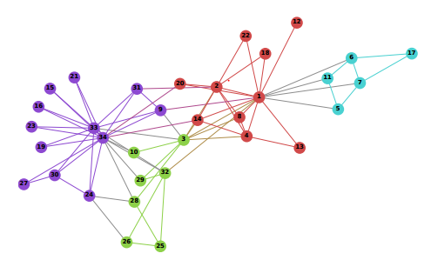
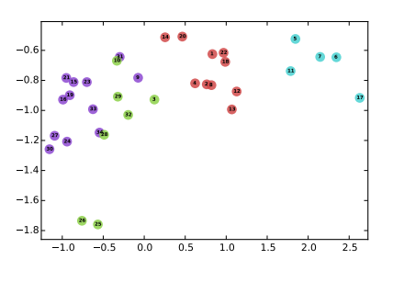
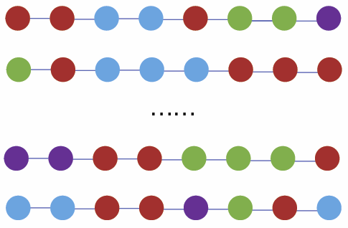
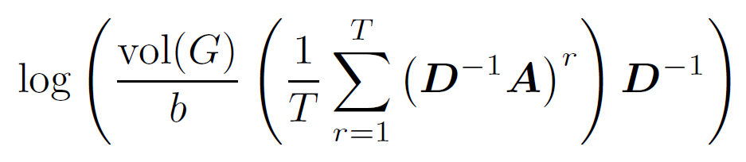
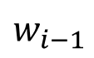

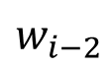
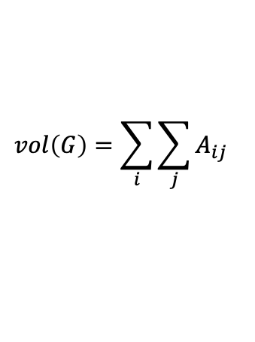
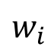
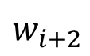
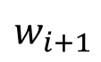

DeepWalk is factorizing a matrix
Matrix Factorization
$$w_{i−2 }$$
$$w_{i−1 }$$
$$w_{i}$$
$$w_{i+1 }$$
$$w_{i+2 }$$
DeepWalk is asymptotically and implicitly factorizing
$$vol\left(G\right)=\sum_{i}{\sum_{j}{A_{ij}}}$$
$$A$$
Adjacency matrix
b: #negative samples
T: context window size
$$D$$
Degree matrix

Slide 18
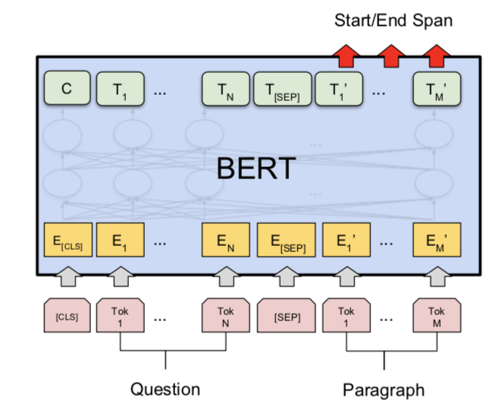
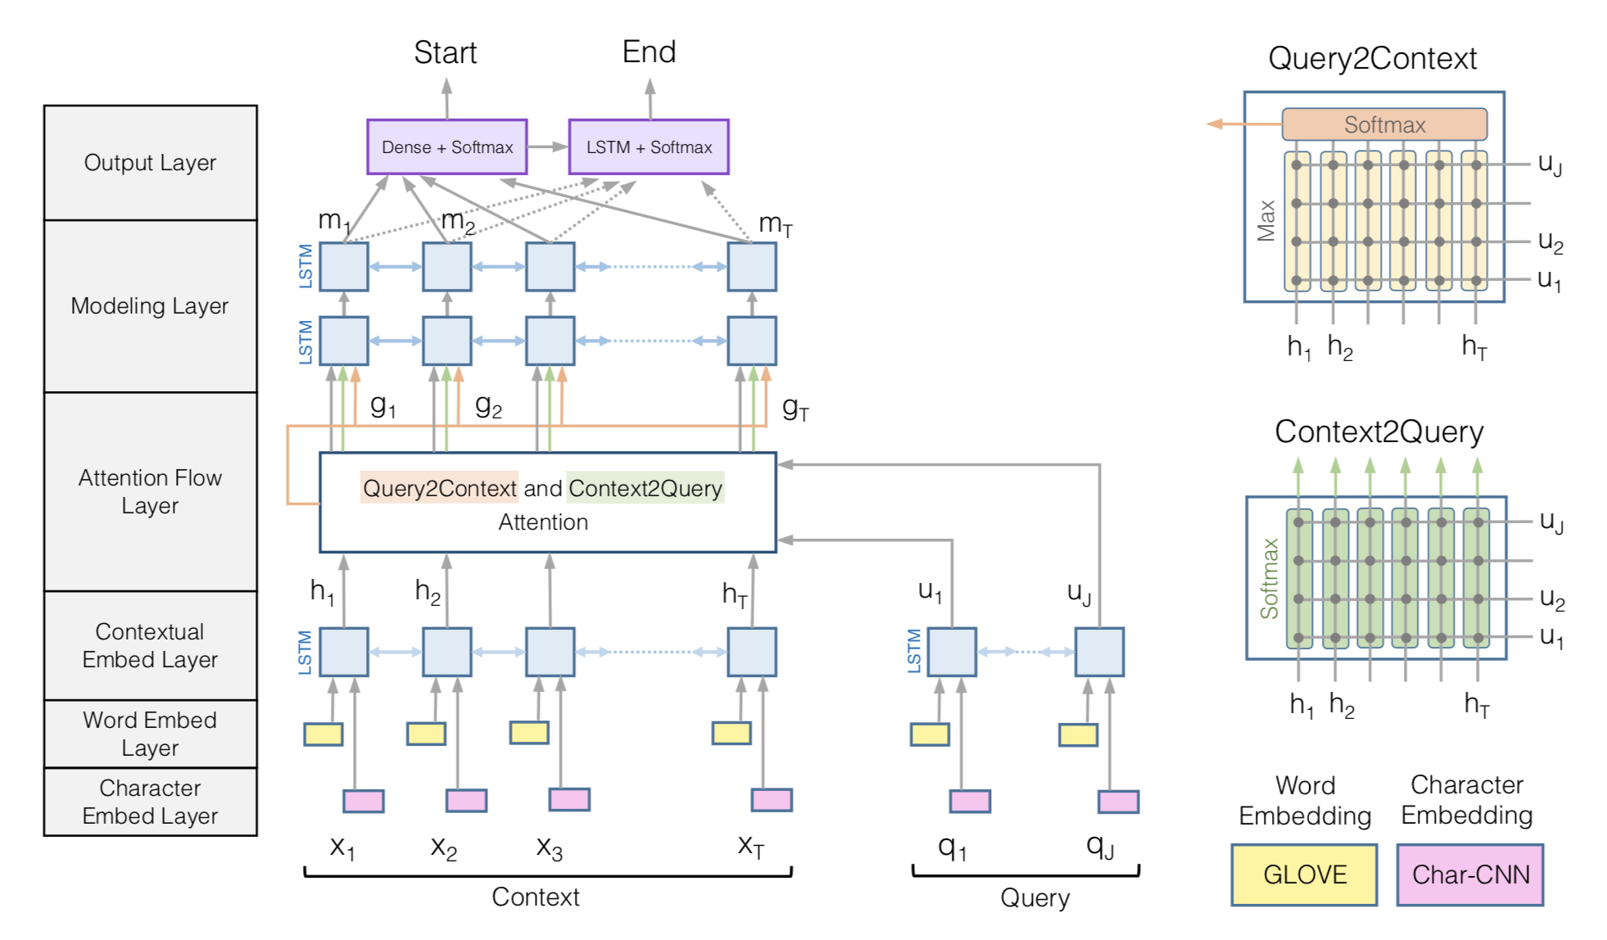
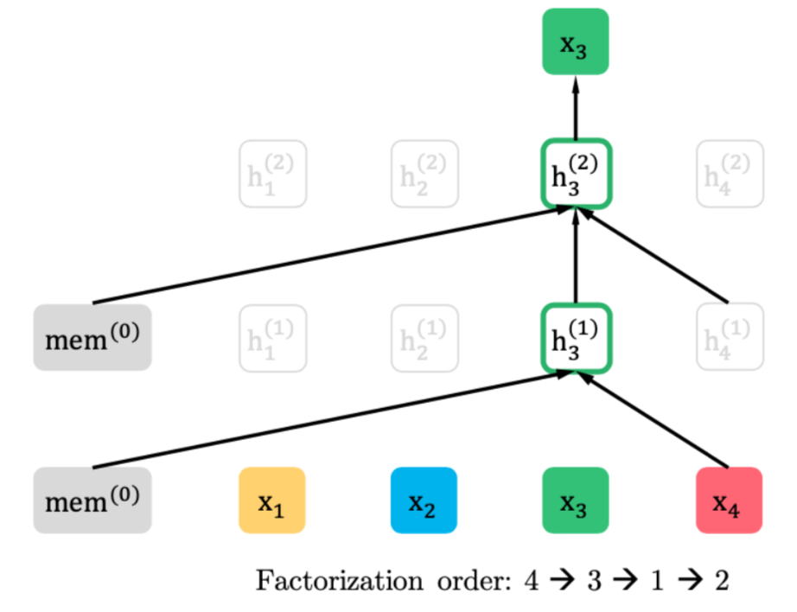
Recent Progress: BIDAF, BERT
reading comprehension: target at understanding the whole paragraph
BiDAF
BERT
XLNet
Rajpurkar, Pranav, et al. "SQuAD: 100,000+ Questions for Machine Comprehension of Text." EMNLP. 2016.

Slide 19
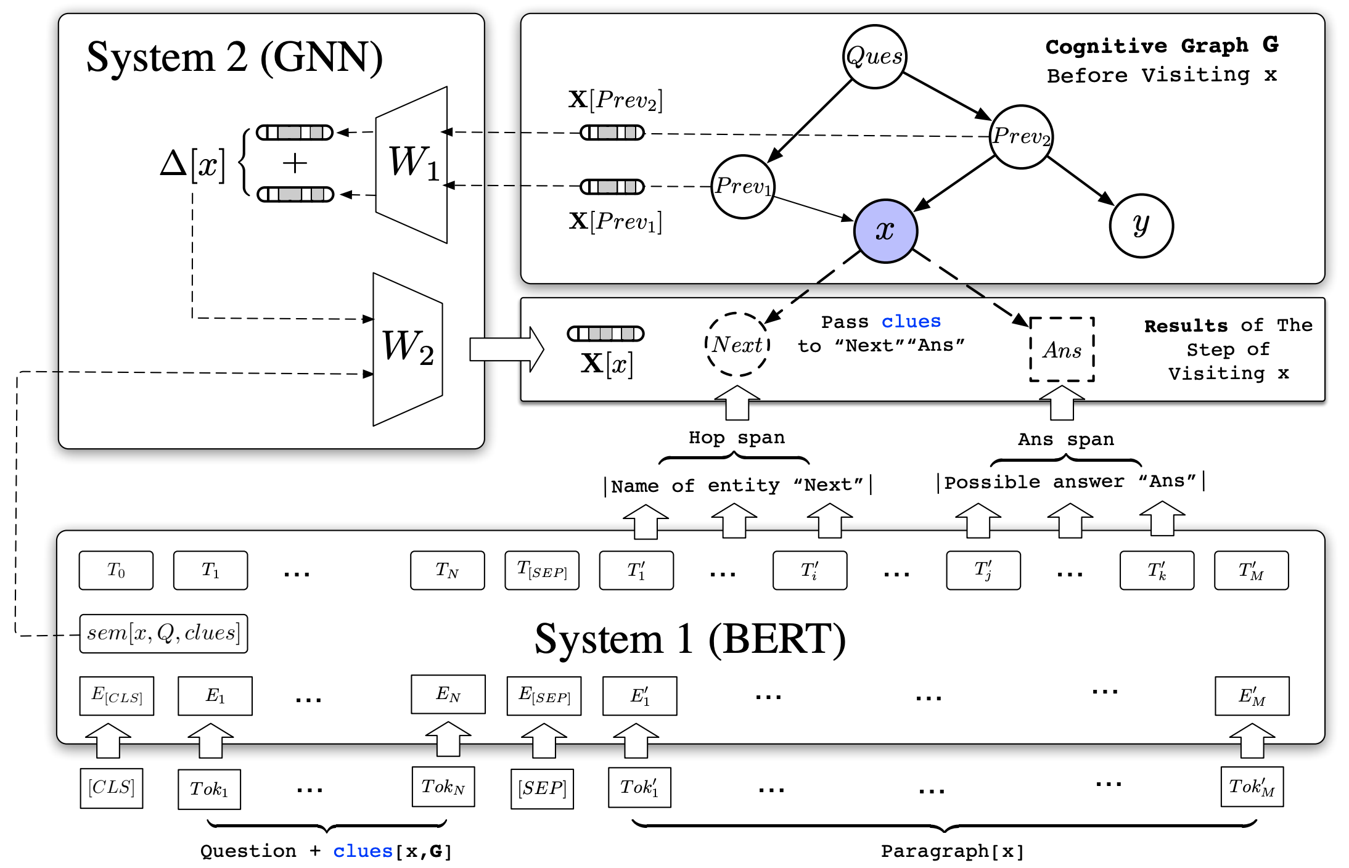
Cognitive Graph: DL + Dual Process Theory
?
System 2: explicit decision
System 1: implicit knowledge expansion
M. Ding, C. Zhou, Q. Chen, H. Yang, and J. Tang. Cognitive Graph for Multi-Hop Reading Comprehension at Scale. ACL’19.

Slide 20
Q2: How to make decision in the cognitive graph?

Slide 21
Cognitive Graph: Representation, Reasoning, and Decision
?
Notes:
Imagine a scenario where you have a wikipedia to look up for any entity, and how can you answer such a question?(click)
Question…
We will first search quality café and los angeless which seems useful for answering the question. Okay there are two quality café but we find CLUES in the middle one there are two films featured here. And then we read the paragraph in wiki about the two films and find out there directors.
Now, we construct a graph step by step, which includes all possible and userful information. And our brain will analyze the whole information and gives the final answer.
We name this graph “cognitive graph”.

Slide 22
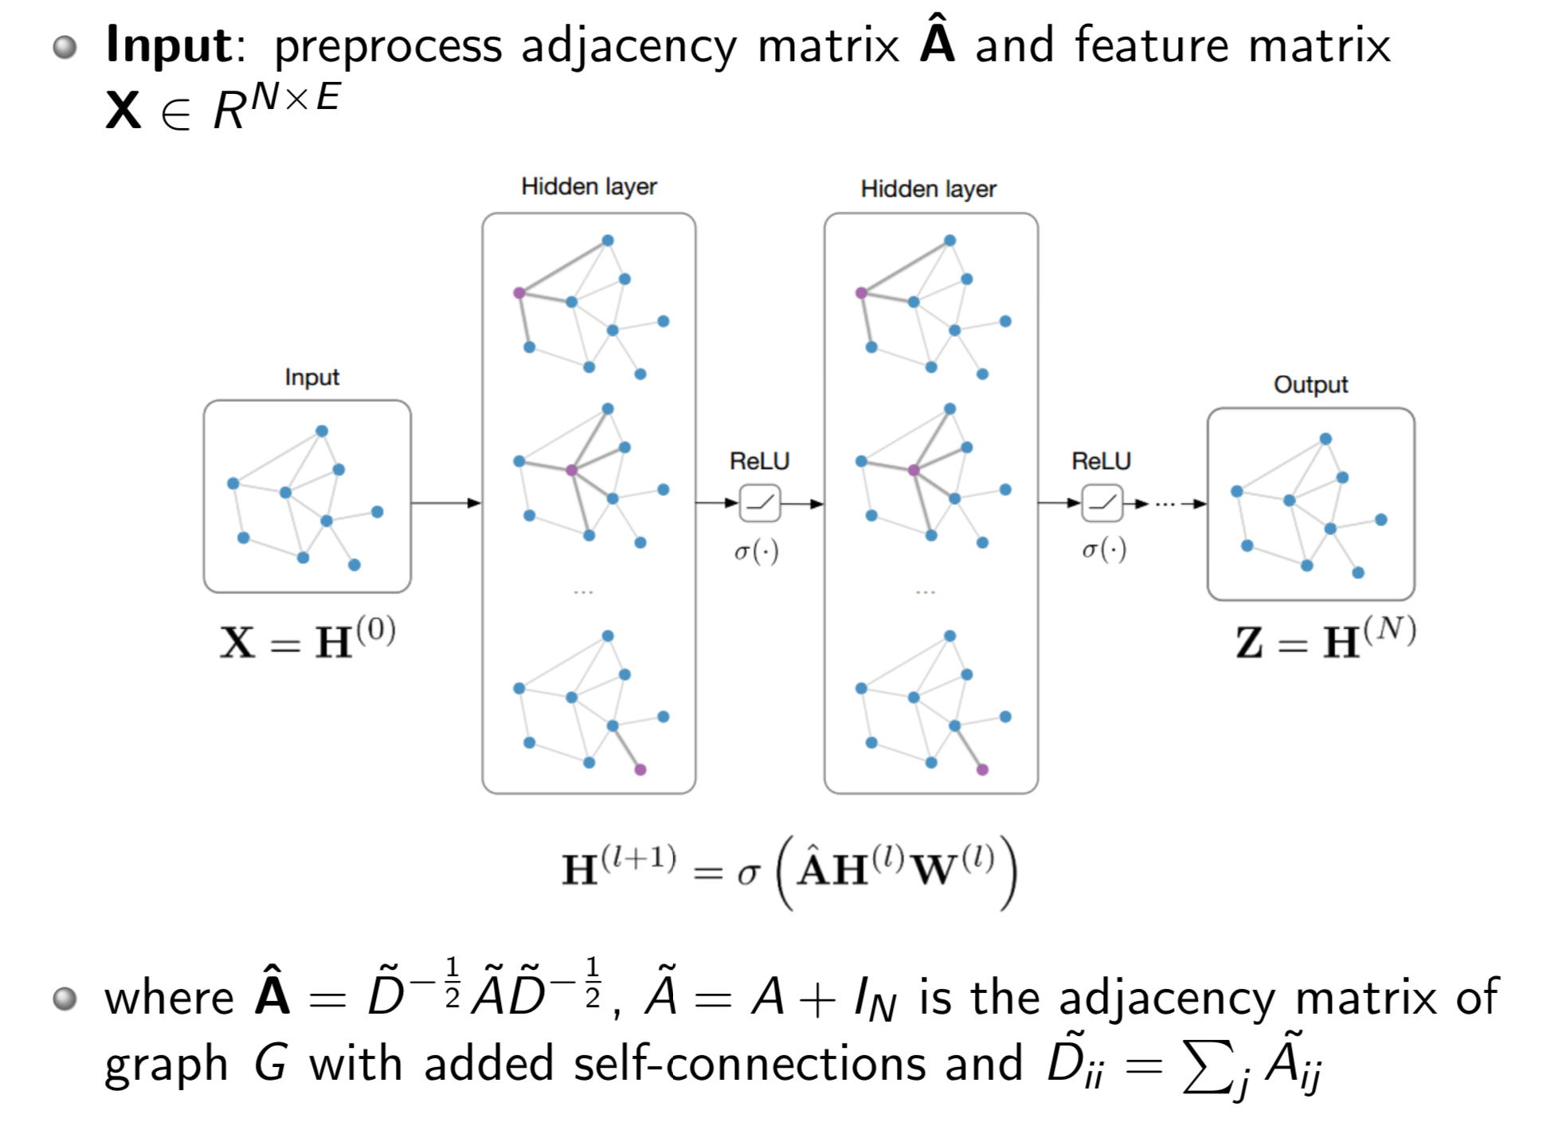
GNN/GCN Model Architecture

Slide 23
Cognitive Graph: DL + Dual Process Theory
System 2: explicit decision
System 1: implicit knowledge expansion
M. Ding, C. Zhou, Q. Chen, H. Yang, and J. Tang. Cognitive Graph for Multi-Hop Reading Comprehension at Scale. ACL’19.

Slide 24
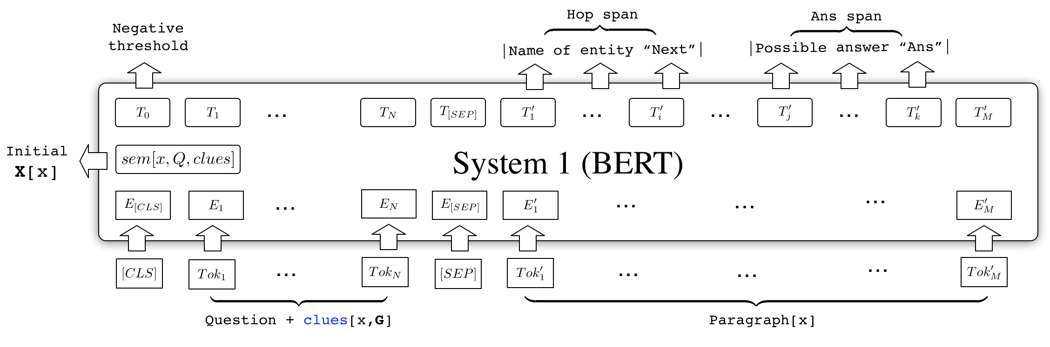
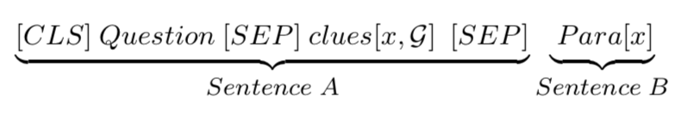
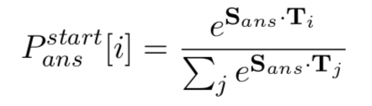
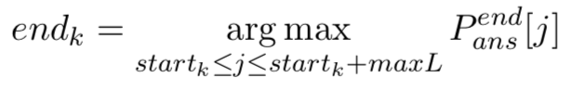
System 1: the BERT Implementation
Extract top-k next-hop entities and answer candidates respectively
Predict the start and end probabilities of each position
Generate semantic vectors for entities based on their documents
Take the 0-th probability as negative threshold
Ignore the spans whose start probabilities are small than the negative threshold

Slide 25
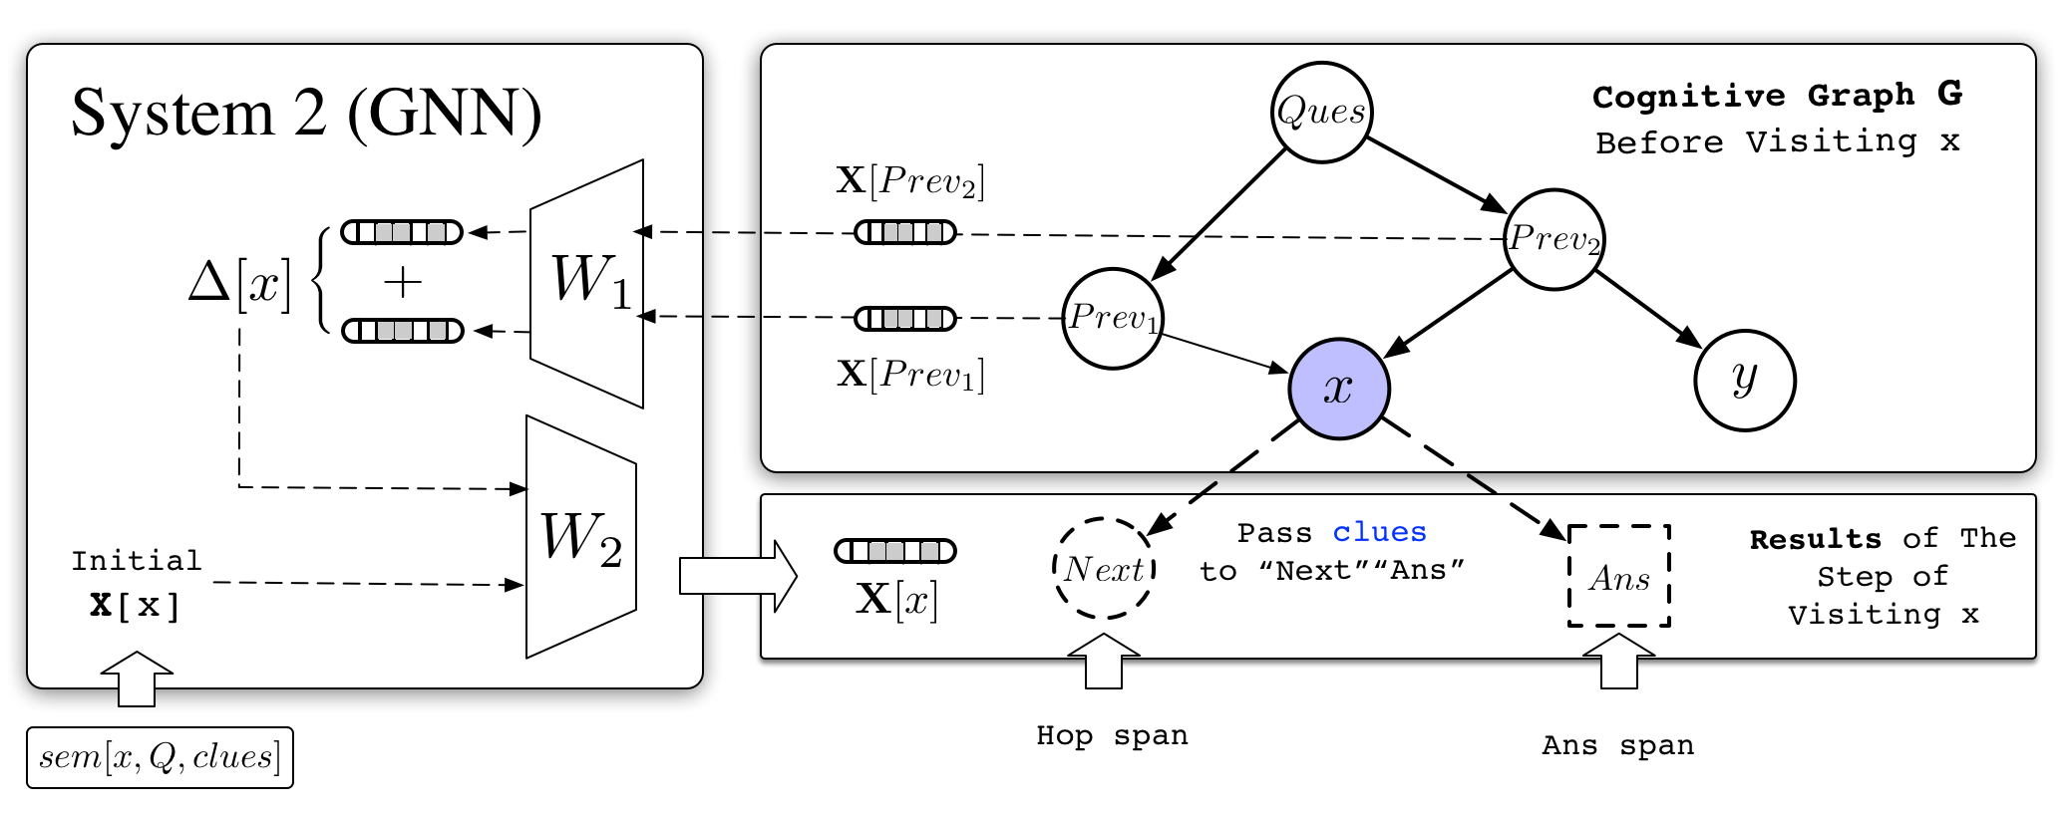
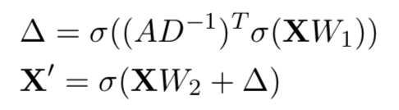
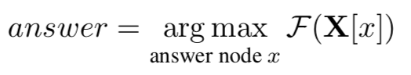
System 2: the GNN implementation
At each step, hidden representations X for nodes are updated according to the propagation rules:
Predictor F is a two-layer MLP, which predicts the final answer based on hidden representations X:

Slide 26
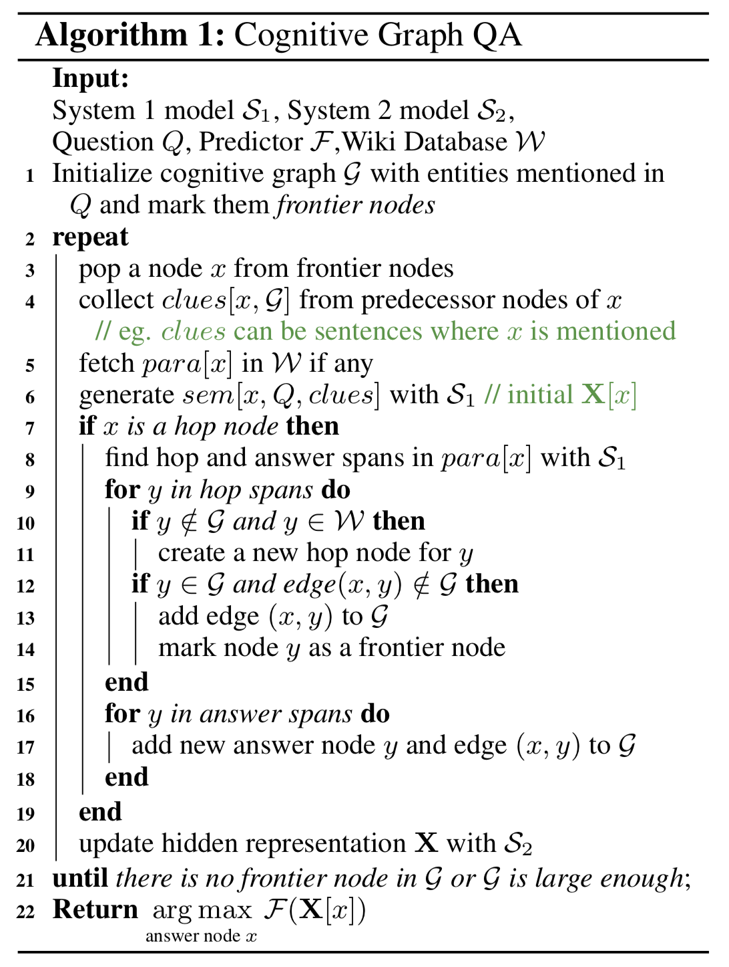
CogQA Algorithm and Training
Preprocess
Mark the spans of next-hop entities and answer by fuzzy matching
Golden cognitive graph and negative (hop and span) nodes
Train Task #1 (System 1)：
Next-hop spans and answer spans extraction
Train Task #2 (System 1 & 2)：
Prediction with GNN

Slide 27
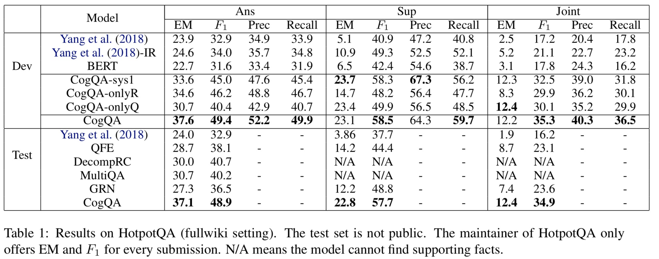
Performance
HotpotQA is a dataset with leaderboard similar to SQuAD
CogQA ranked 1st from 21, Feb to 15, May (nearly 3 month)
** Code available at https://github.com/THUDM/CogQA
Notes:
Two things to note:
Yang-IR: improved retrieval. We improve the retrieval process of Yang et al. for better comparison.
CogQA-onlyQ is designed that it only starts with the entities that appear in the question.
Free of elaborate retrieval methods, this setting can be regarded as a natural thinking pattern of human being, in which only explicit and reliable relations are needed in reasoning. CogQA-onlyQ still outperforms all the baselines

Slide 28
Reasoning Power
CogQA Performs much better on question with more hops！
Notes:
CogQA Performs much better on question with more hops

Slide 29
Case Study
Tree-shape Cognitive Graph
Users can verify the answer by comparing it with another possible reasoning chain.
“Upper House” in the question is similar to “Senate” not “House of Representative”
Notes:
We show how the cognitive graph clearly explains complex reasoning processes in our experiments.
The cognitive graph highlights the heart of the question in case (1) – i.e., to choose between the number of members in two houses. CogQA makes the right choice based on semantic similarity between “Senate” and “upper house”.
Case (2) illustrates that the robustness of answering can be boosted by exploring parallel reasoning paths.
In Case (3) our model finally gets the answer “Marijus Adomaitis” while the annotated ground truth is “Ten Walls”. However, when backtracking the reasoning process in cognitive graph, we find that the model has already reached “Ten Walls” and answers with his real name, which is acceptable and even more accurate. This is why we need explainability.

Slide 30
Case Study
DAG-shape Cognitive Graph
Multiple supporting facts provides richer information, increasing the credibility of the answer.

Slide 31
Case Study
CogQA gives the answer “Marijus Adomaitis” while the ground truth is “Ten Walls”.
By examining, Ten Walls is just the stage name of Marijus Adomaitis!
Without cognitive graphs, black-box models cannot achieve it.

Slide 32
Summary
Iterative Framework --> Myopic Retrieval
Cognitive Graph --> Explainability
Dual process theory --> System 2 Reasoning
Cognitive graph
CogQA framework

Slide 33
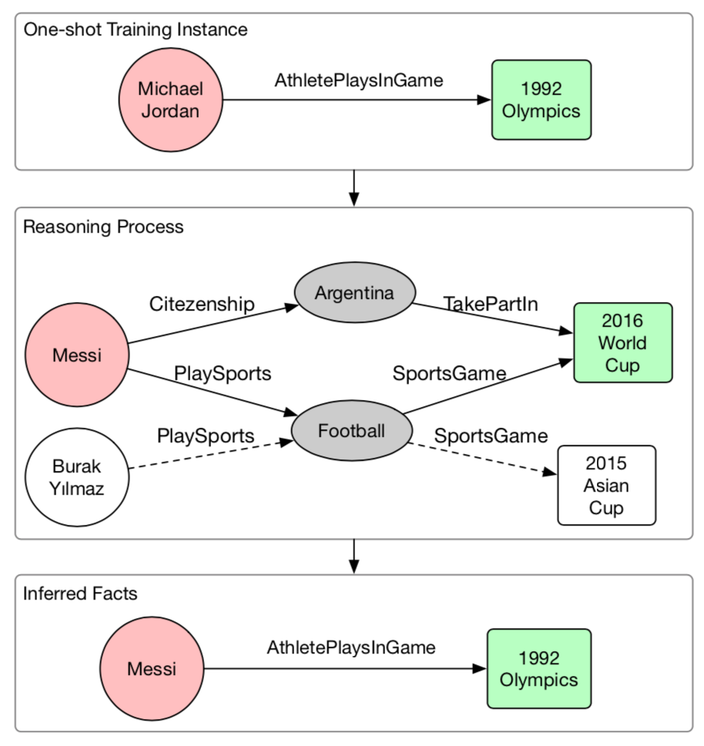
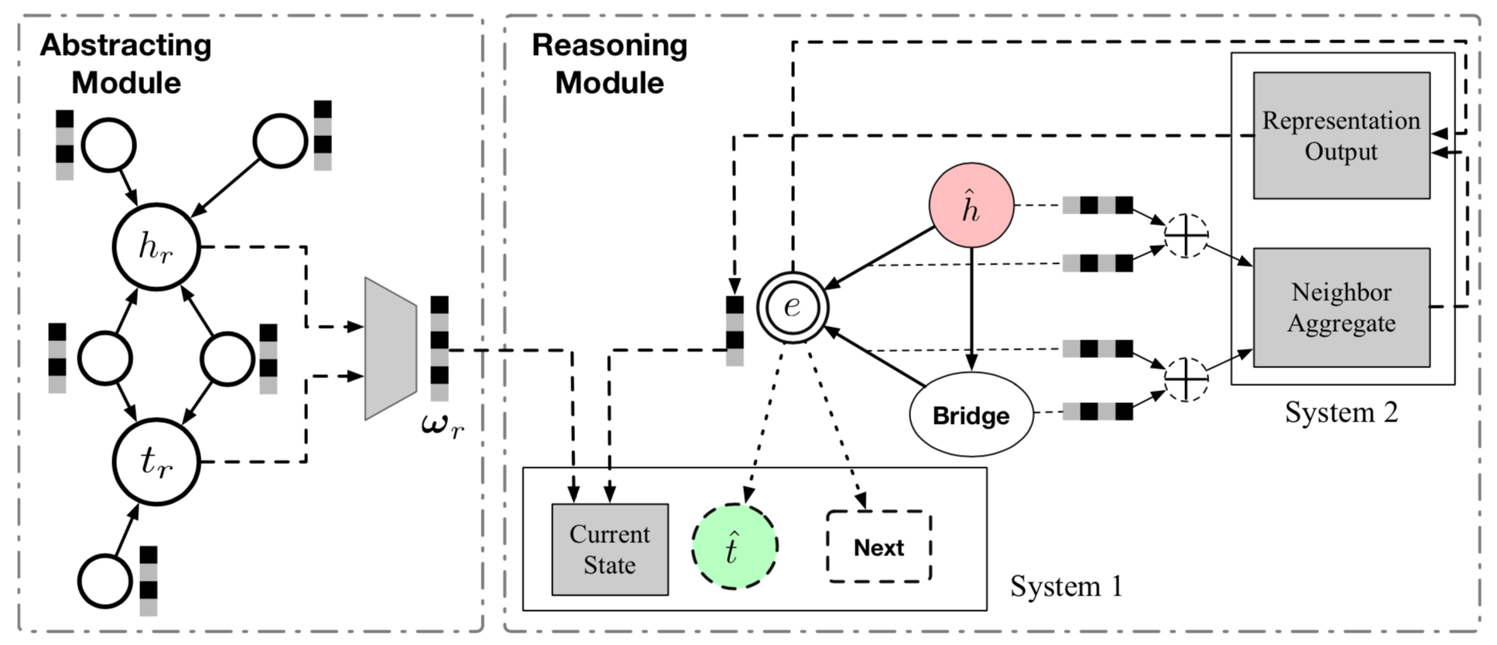
More Applications: KG completion
Completing knowledge graph with cognitive graph

Slide 34
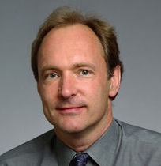
Cognitive Graph —Trillion-scale common-sense knowledge graph
Edward Feigenbaum
Turing Award Winner
Tim Berners Lee
Turing Award Winner
Big Data
Knowledge
Intelligence
* AI = Knowledge + Intelligence
J. Tang, J. Zhang, L. Yao, J. Li, L. Zhang, and Z. Su. ArnetMiner: Extraction and Mining of Academic Social Networks. KDD’08. pp.990-998.

Slide 35
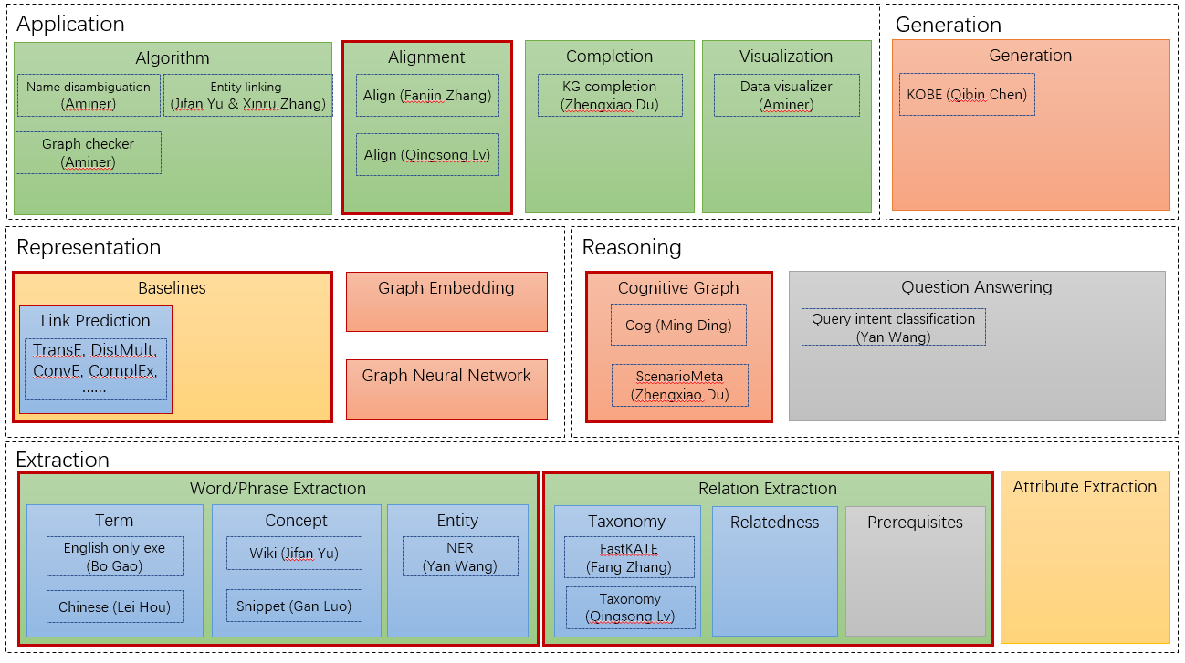
CogDL: Cognitive Graph Toolkit http://keg.cs.tsinghua.edu.cn/cogdl

Slide 36
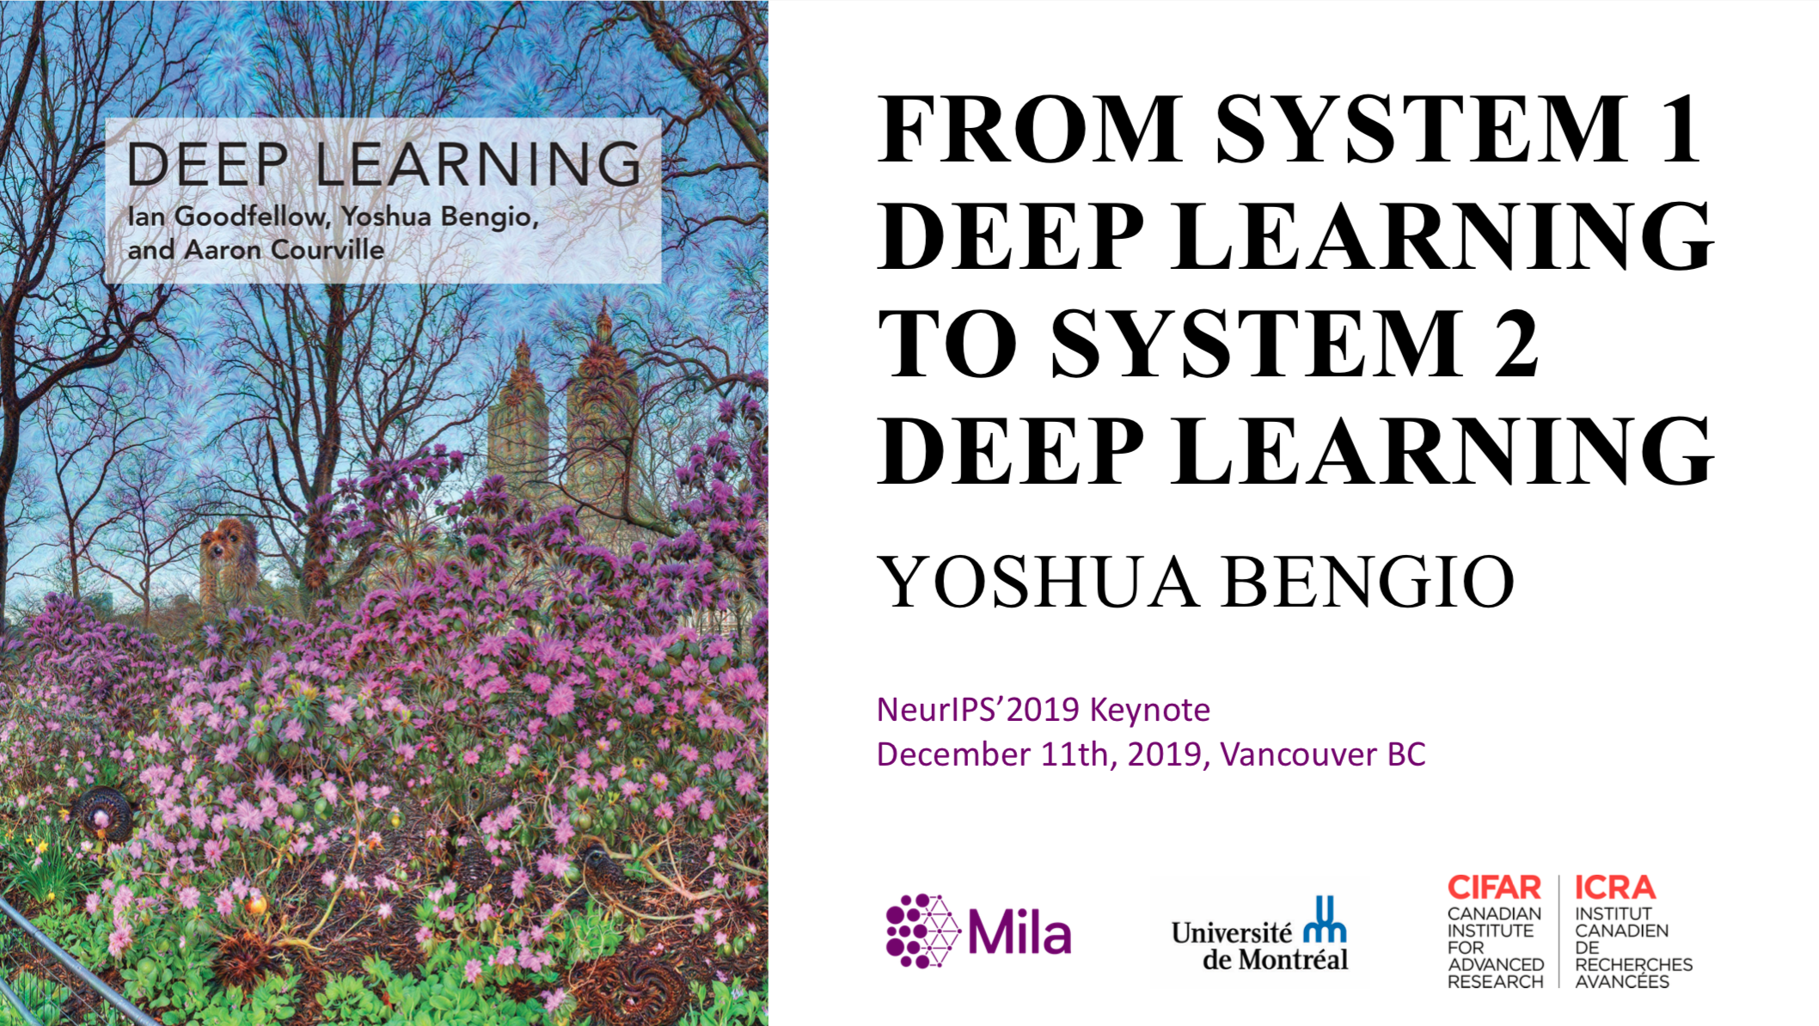
From Bengio’s NIPS’2019 Keynote

Slide 37
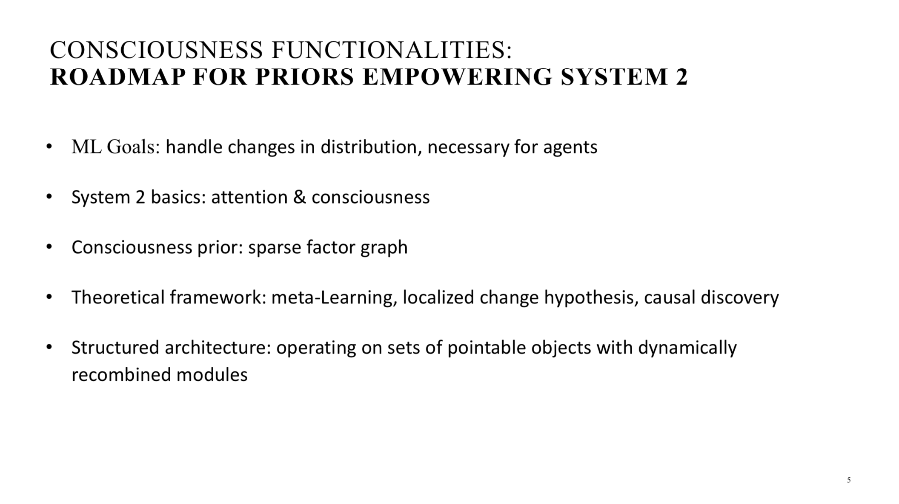
From Bengio’s NIPS’2019 Keynote

Slide 38
I am going to conclude…

Slide 39
Overview of Class
Introduction
Support Vector Machines
NB & LR
Clustering
Dimension Reduction
Learning Theory
Reinforcement Learning
Deep Generative Models for Text Generation
Deep Forward Networks
Convolutional Networks
Autoencoders + Sequential Neural Networks
Invited Talk: Lei Li (ByteDance)
Network Embedding + GNN
GAN + Adversarial Learning
Reinforcement Learning
Cognitive Graph: DL from system 1 to system 2

Slide 40
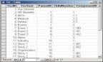
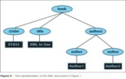
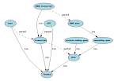

Overview of Class (cont.)
Supervised learning
Unsupervised learning
Machine Learning
Lectures on ML
Evaluation
Seminar-style class
Generative
learning
Topic model
Non-parametric
Representation learning
Convolutional networks
Discriminative
learning
SVM
CRF
Max-margin
Sparse coding
Adversial learning
Presentation
Algorithm design
Projects
(50 points)
Novelty (20)
Completeness (30)
Homework
(50 points)
Correctness
efficiency
Output
New algorithms
Paper
Fun!
In this course, we try to learn something
and try to achieve something…

Slide 41
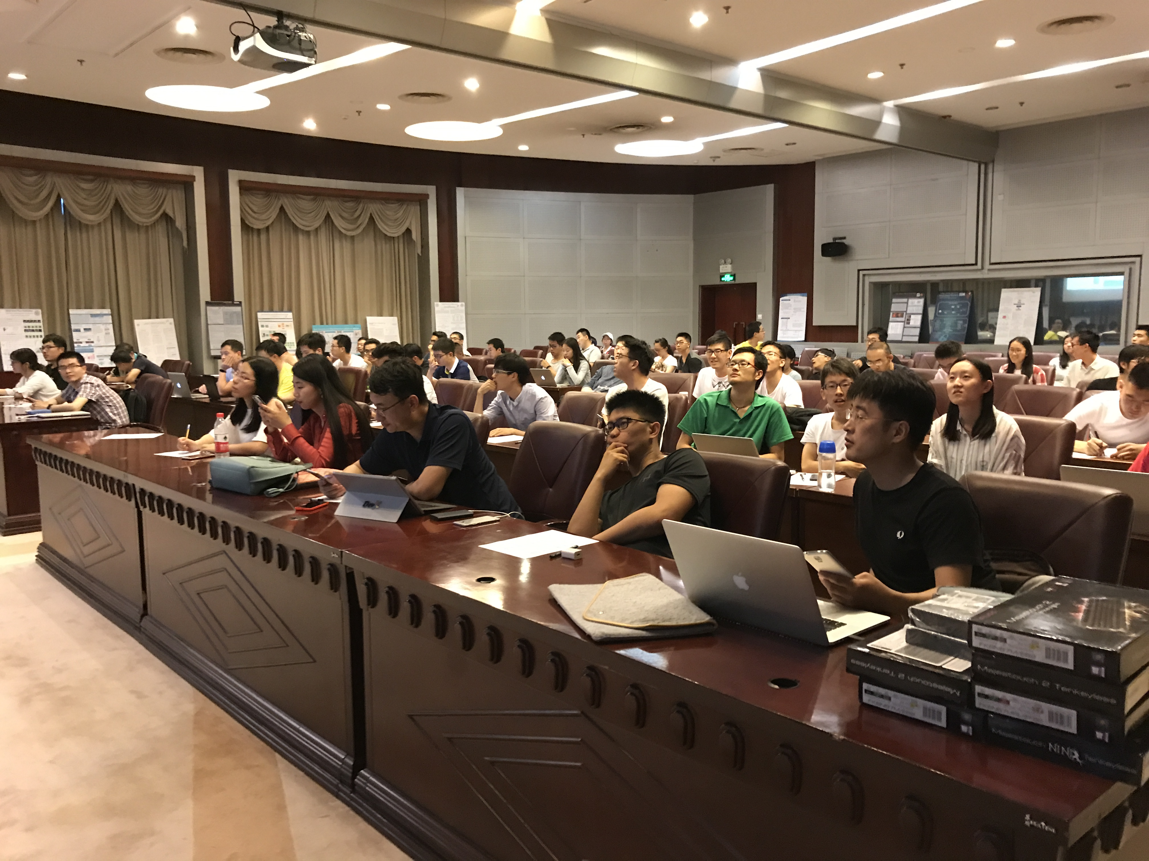
Final Presentation

Slide 42
Related Publications
Ming Ding, Chang Zhou, Qibin Chen, Hongxia Yang, and Jie Tang. Cognitive Graph for Multi-Hop Reading Comprehension at Scale. ACL’19.
Jie Zhang, Yuxiao Dong, Yan Wang, Jie Tang, and Ming Ding. ProNE: Fast and Scalable Network Representation Learning. IJCAI’19.
Yukuo Cen, Xu Zou, Jianwei Zhang, Hongxia Yang, Jingren Zhou and Jie Tang. Representation Learning for Attributed Multiplex Heterogeneous Network. KDD’19.
Fanjin Zhang, Xiao Liu, Jie Tang, Yuxiao Dong, Peiran Yao, Jie Zhang, Xiaotao Gu, Yan Wang, Bin Shao, Rui Li, and Kuansan Wang. OAG: Toward Linking Large-scale Heterogeneous Entity Graphs. KDD’19.
Yifeng Zhao, Xiangwei Wang, Hongxia Yang, Le Song, and Jie Tang. Large Scale Evolving Graphs with Burst Detection. IJCAI’19.
Yu Han, Jie Tang, and Qian Chen. Network Embedding under Partial Monitoring for Evolving Networks. IJCAI’19.
Jiezhong Qiu, Yuxiao Dong, Hao Ma, Jian Li, Chi Wang, Kuansan Wang, and Jie Tang. NetSMF: Large-Scale Network Embedding as Sparse Matrix Factorization. WWW'19.
Jiezhong Qiu, Jian Tang, Hao Ma, Yuxiao Dong, Kuansan Wang, and Jie Tang. DeepInf: Modeling Influence Locality in Large Social Networks. KDD’18.
Jiezhong Qiu, Yuxiao Dong, Hao Ma, Jian Li, Kuansan Wang, and Jie Tang. Network Embedding as Matrix Factorization: Unifying DeepWalk, LINE, PTE, and node2vec. WSDM’18.
Jie Tang, Jing Zhang, Limin Yao, Juanzi Li, Li Zhang, and Zhong Su. ArnetMiner: Extraction and Mining of Academic Social Networks. KDD’08.
For more, please check here http://keg.cs.tsinghua.edu.cn/jietang

Slide 43
Thank you！
Collaborators:
Jie Zhang, Ming Ding, Jiezhong Qiu, Qibin Chen, Yifeng Zhao, Yukuo Cen, Yu Han, Fanjin Zhang, Xu Zou, Yan Wang, et al. (THU)
Hongxiao Yang, Chang Zhou, Le Song, Jingren Zhou, et al. (Alibaba)
Yuxiao Dong, Chi Wang, Hao Ma, Kuansan Wang (Microsoft)
Jie Tang, KEG, Tsinghua U http://keg.cs.tsinghua.edu.cn/jietang
Download all data & Codes https://keg.cs.tsinghua.edu.cn/cogdl/
https://github.com/THUDM

